Slide 1
AWS SERVICES
N.SRI .VIJAYA LAKSHMI
20a31a0419

Slide 2
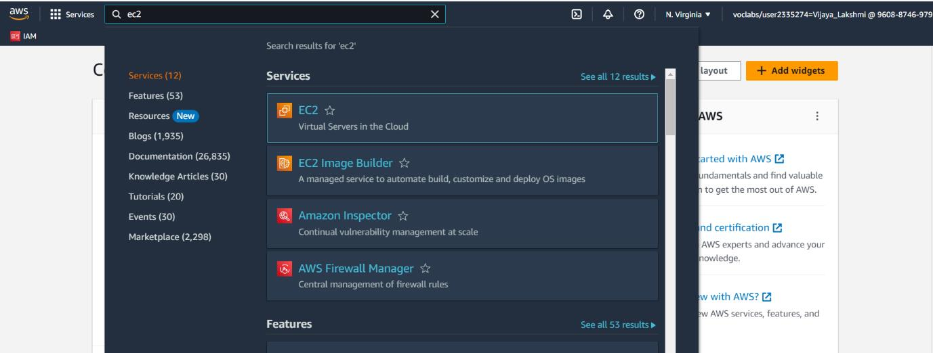
Creating An EC2 Instance
Step-1 : Firstly ,we have to login to the AWS
accounts with username and password
Step-2 : After logging in ,click on services and
search for EC2 instance and select it

Slide 3
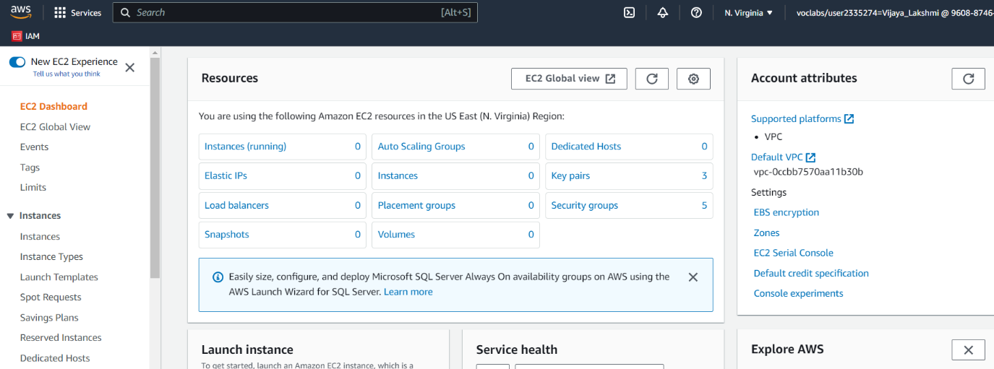
Step-3: After clicking on EC2 ,Ec2 dashboard appears

Slide 4
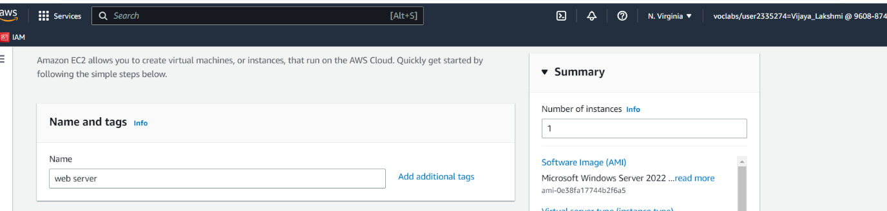
Step-4:Click on Launch Instance then a window appears, Give a name to the server and also Give a key pair name and create key pair and main is Instance type is t2.micro

Slide 5
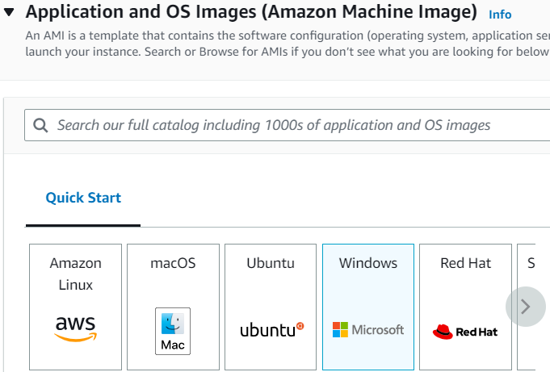
Select AMI here, I select windows

Slide 6
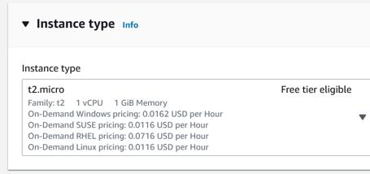
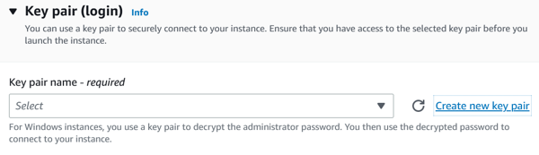
Instance type
Where key pair name can be a instance name
where we will not get any confusion further

Slide 7
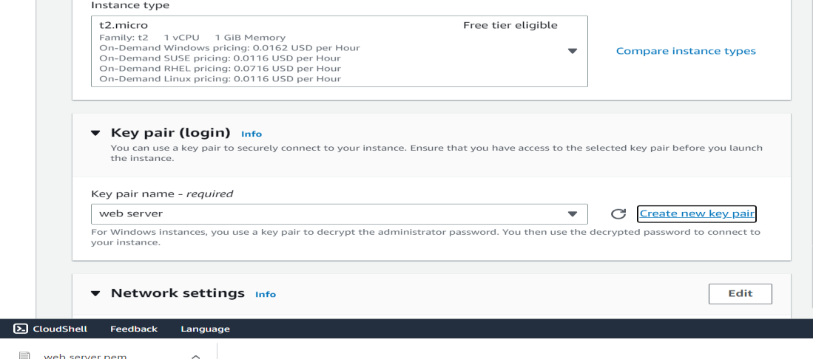
Using pem file format and after that launch
instance

Slide 8
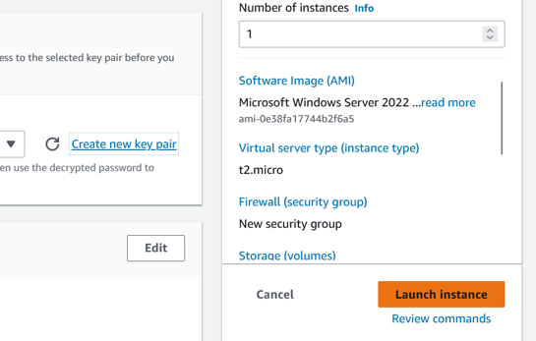
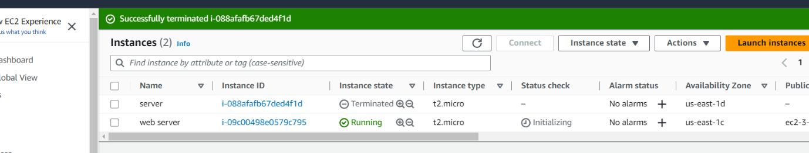
Step 5:The Instance will be Launched and you can see In instances

Slide 9
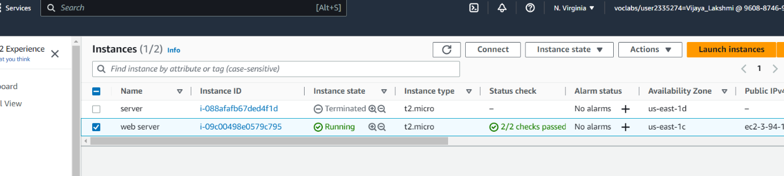
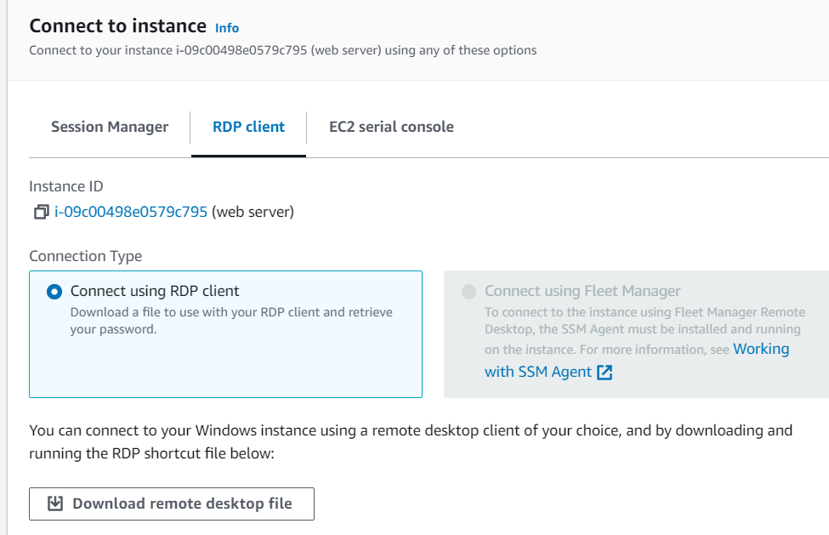
We can observe the state of instance here i.e., running
Step-6: Select the instance and click connect
Step-7: After that , click on RDP client

Slide 10
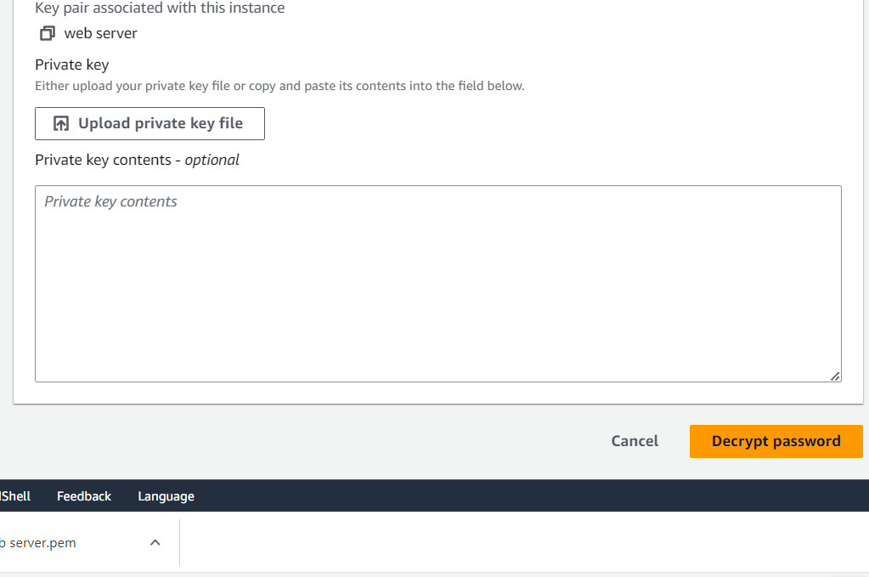
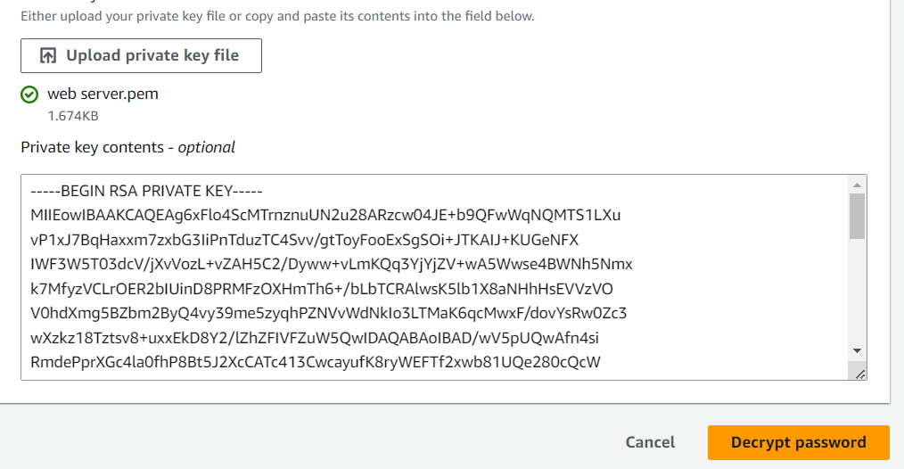
And click on get password
Step-8: upload server pem file to upload private key f ile and then decrypt password

Slide 11
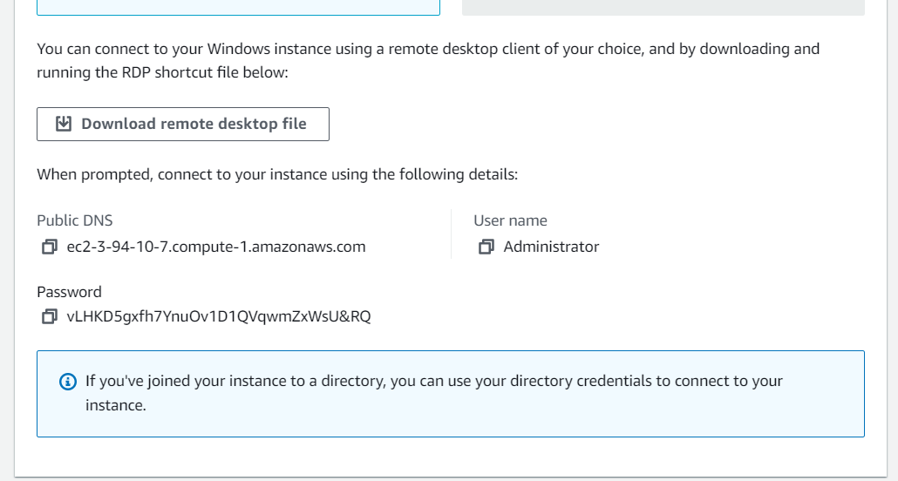
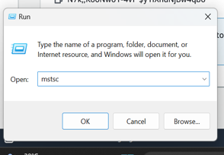
Step-9:After the password is decrypted , the window appears as follows and save the username , public DNS and password
Step -10: Now click on search bar and click run and t ype mstsc
Step-11: Paste the copied DNS name and then click connect

Slide 12
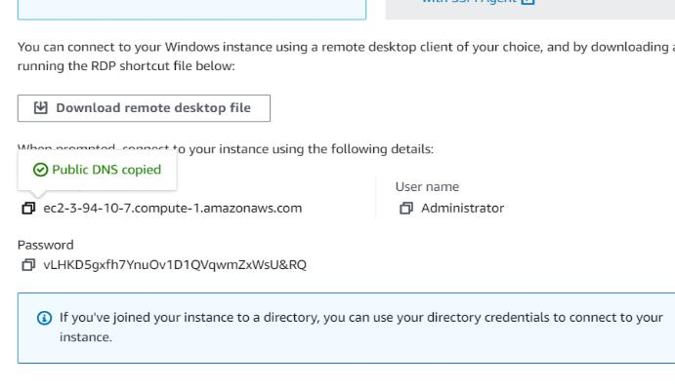
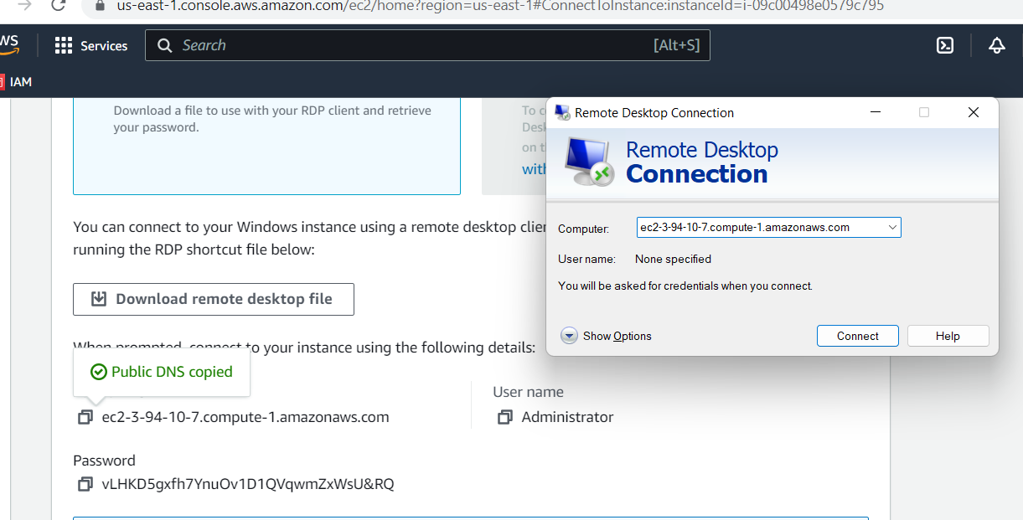
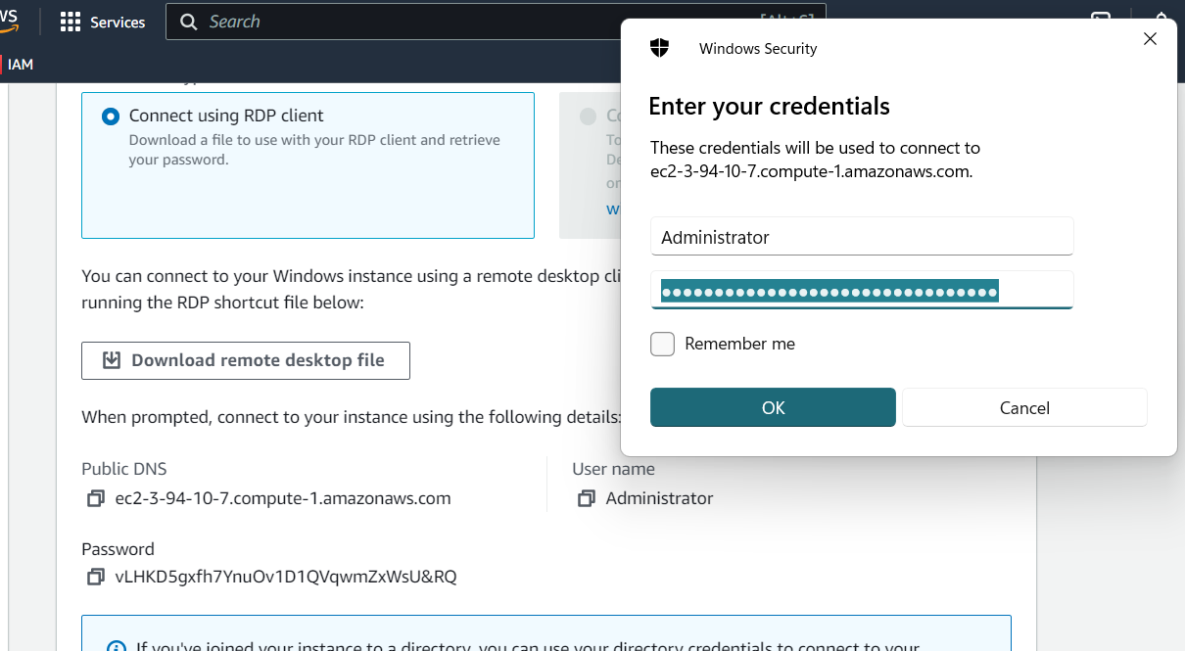
Step-12:Copy and paste the username and password which we copied earlier and then click okay

Slide 13
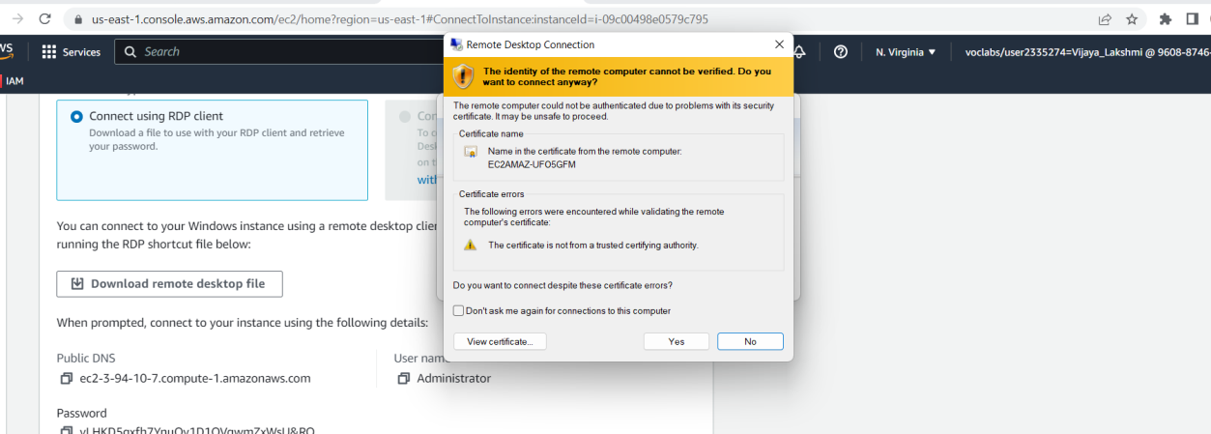
Step-13:Then a pop up window appears, click yes
Step-14:Now a Windows desktop appears as follows .To go back to the original desktop click X mark and then click ok

Slide 14
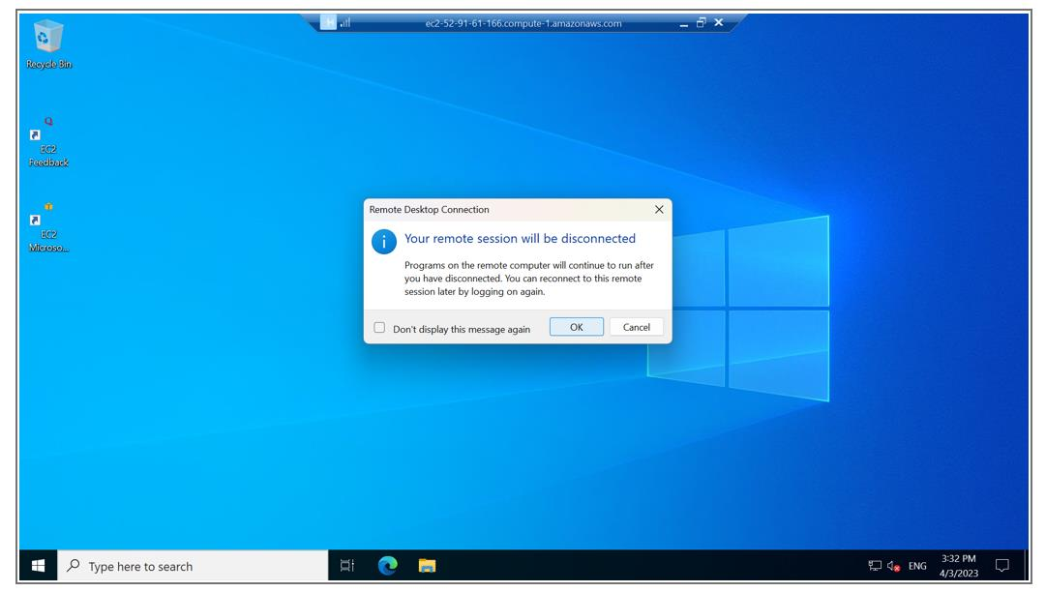

Slide 15
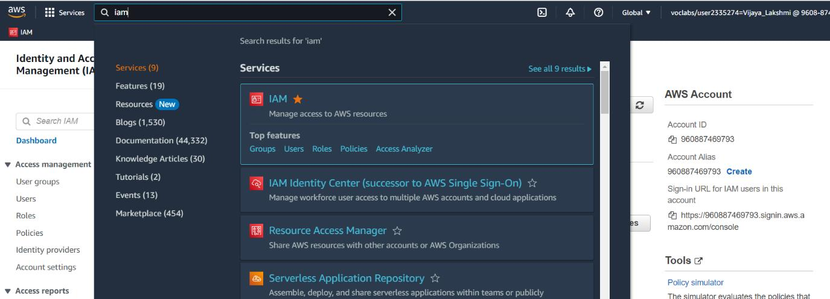
CREATING AWS IAM
Step-1 : Firstly ,we have to login to the AWS accounts with username and password
Step-2 : After logging in ,click on services and search for IAM service and select it

Slide 16
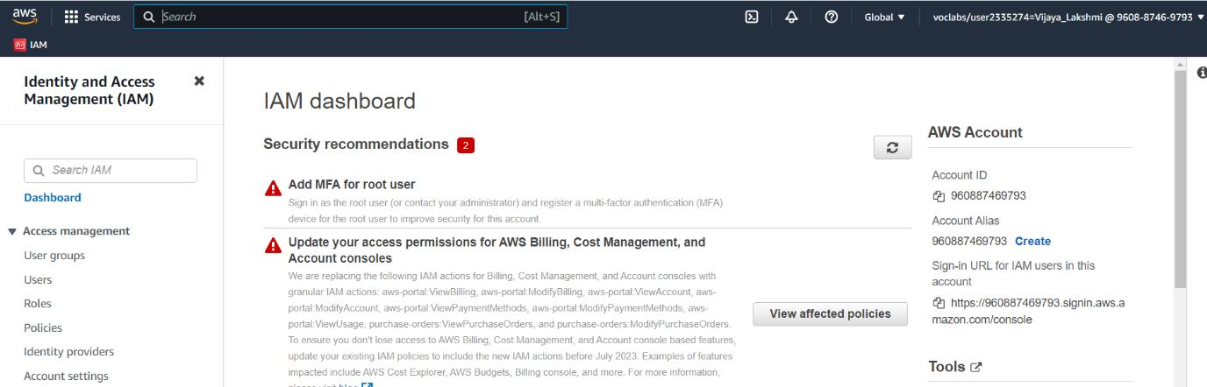
Step -3: Now a we can see user groups on left side panel click on it

Slide 17
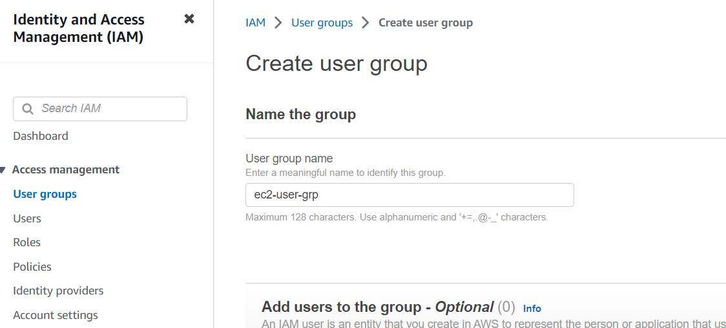
Step-4: Now create a group
Step -5: Attach permissions

Slide 18
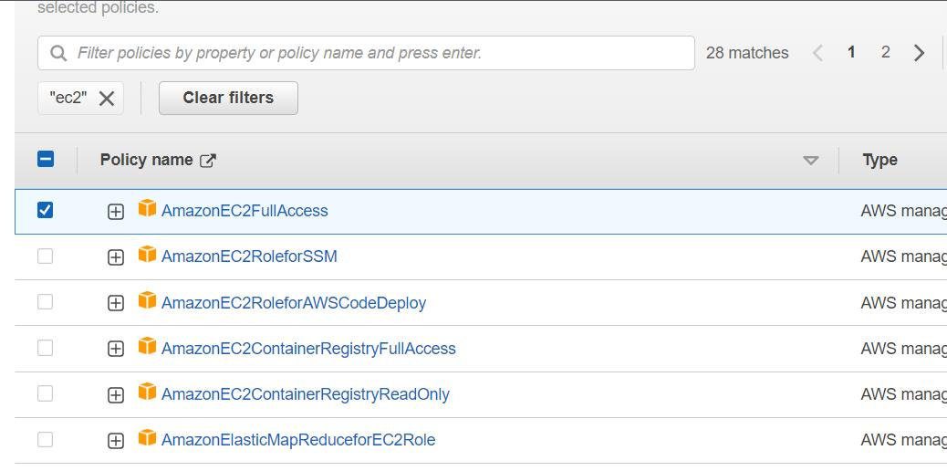
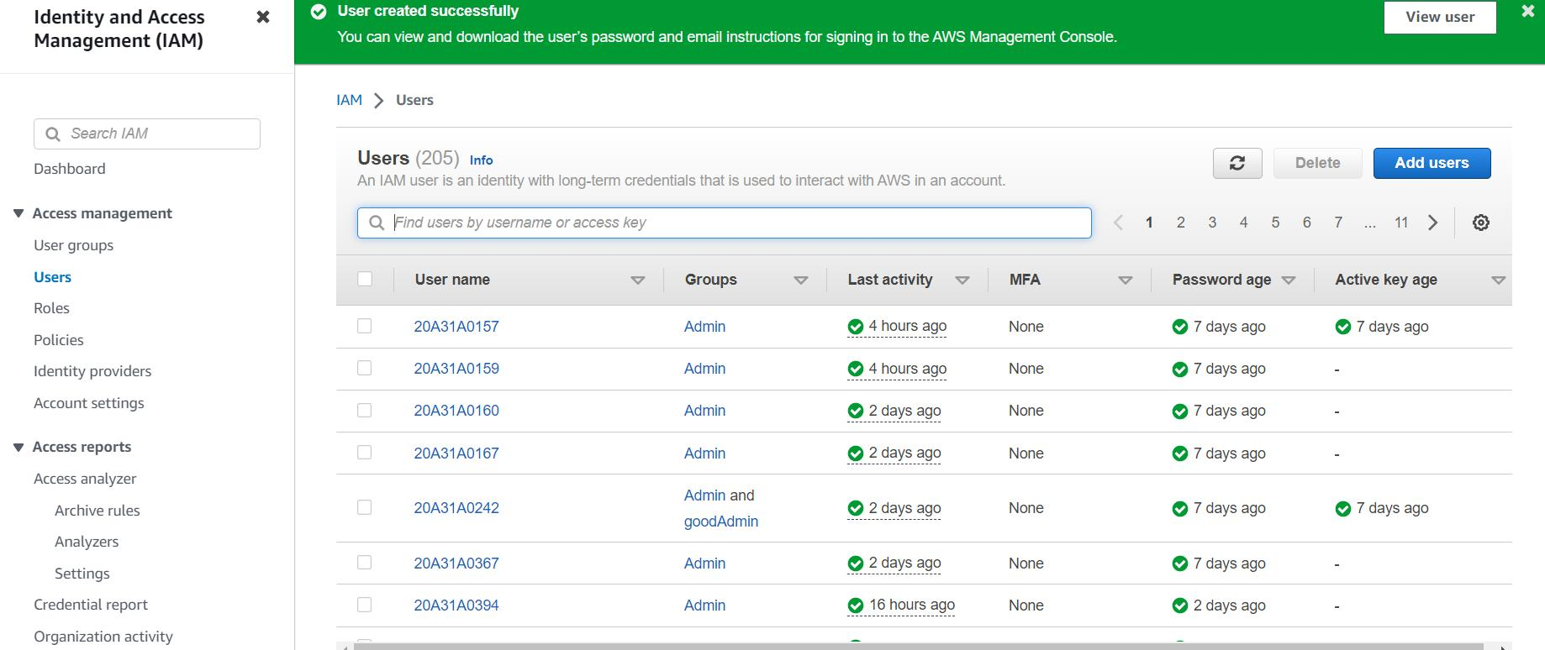
Now create group
Step -6: create user
7.Now left pane click on users and then select
add users
8.Give the user name and click on next ,next
and create user9.User successfully created
Now create group
Step -6: create user
7.Now left pane click on users and then select add users
8.Give the user name and click on next ,next and create user9.User successfully created

Slide 19
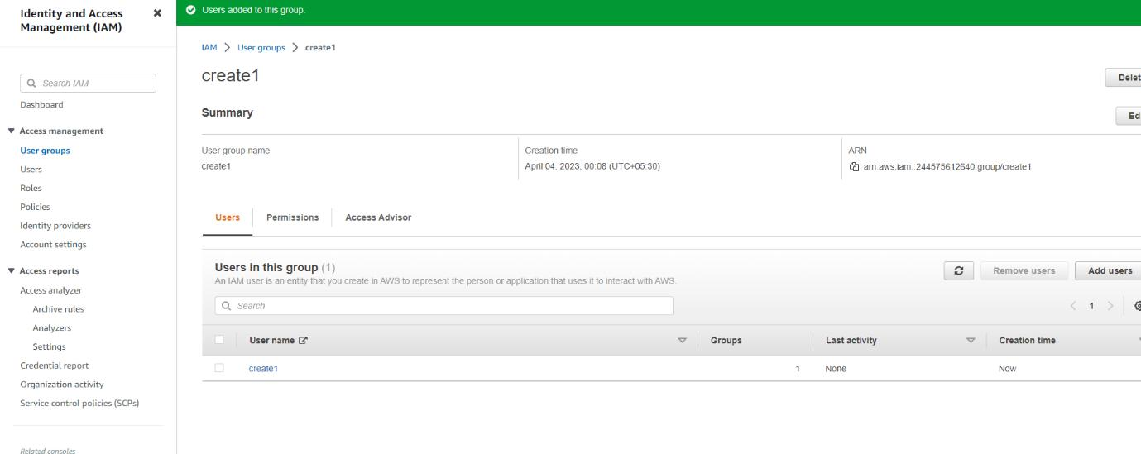
10.Now click on user group and select group which we created before
11.Scoll down we add user click on it and select the user which we created
12. Finally we created adding users to the group

Slide 20
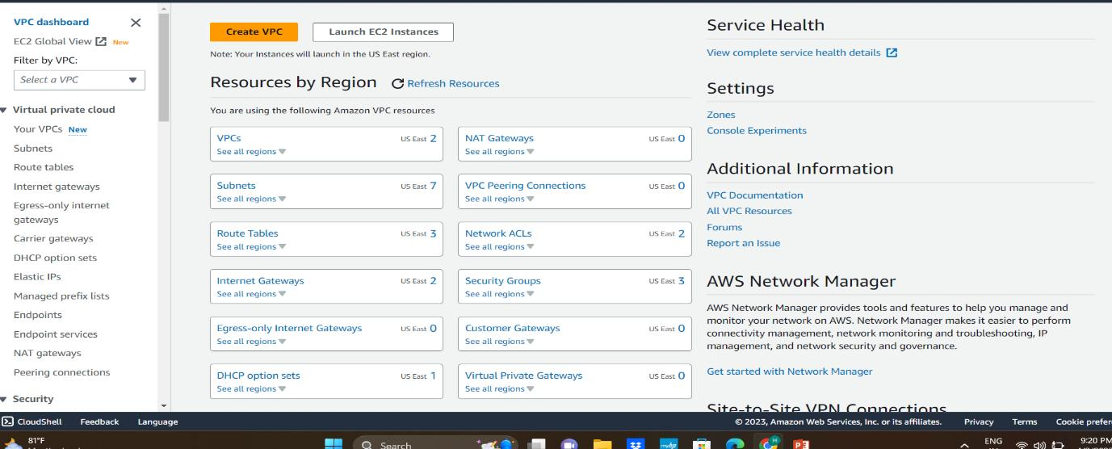
VPC(Virtual Private Cloud)
Steps:
1. AWS Management Console choose service, choose vpc
2.At the top check the location N. Virginia (us-east-1)
3.Choose the create vpc

Slide 21
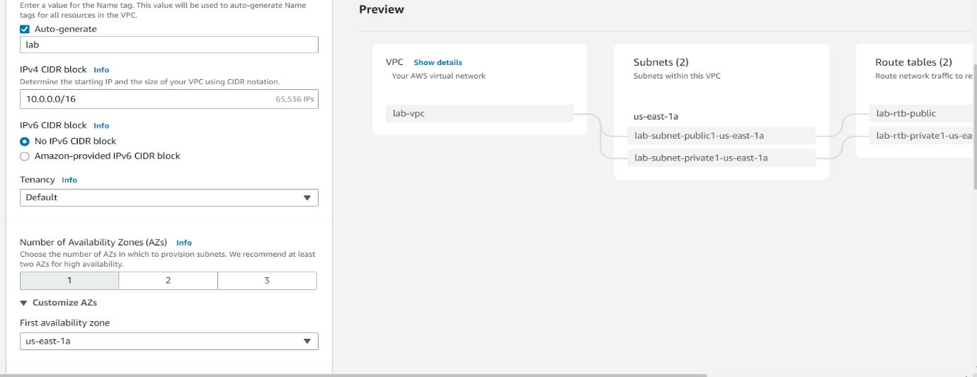
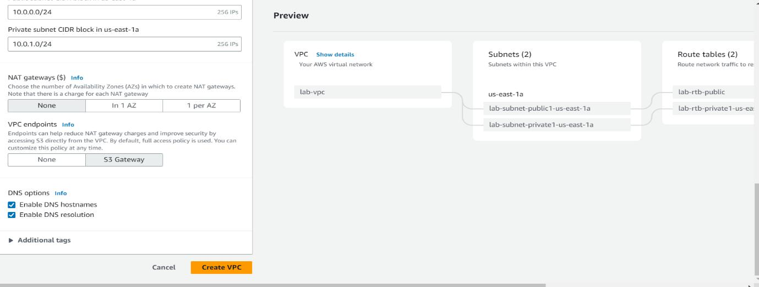
4. Type the name of the vpc
5. Set the no of Availability Zones
6. Adjust the ip address of public and private ,NAT gateways and VPC endpoints
7.Click on the create vpc

Slide 22
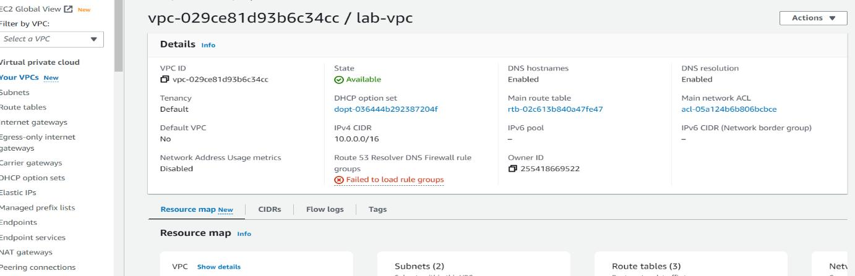
8. Click on view vpc
9. In the left navigation pane, choose Subnets.
10.Click on create subnets

Slide 23
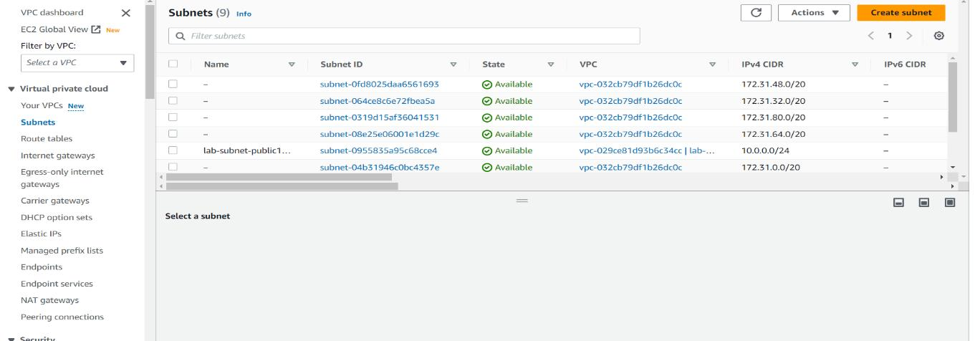
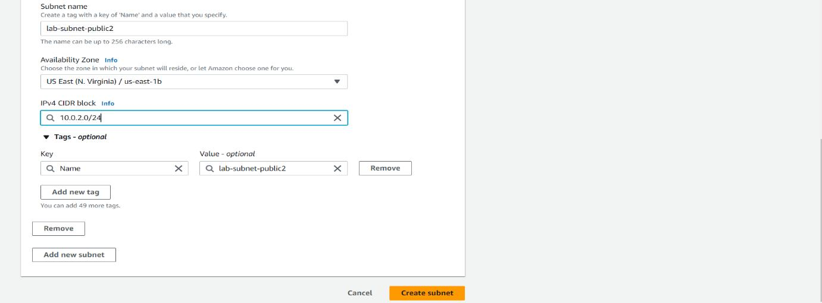
11. VPC ID: lab-vpc (select from the menu). Subnet name: lab-subnet-public2Availability Zone: Select the second Availability Zone (for example, us-east-1b) IPv4 CIDR block: 10.0.2.0/24
12. Click on create subnet

Slide 24
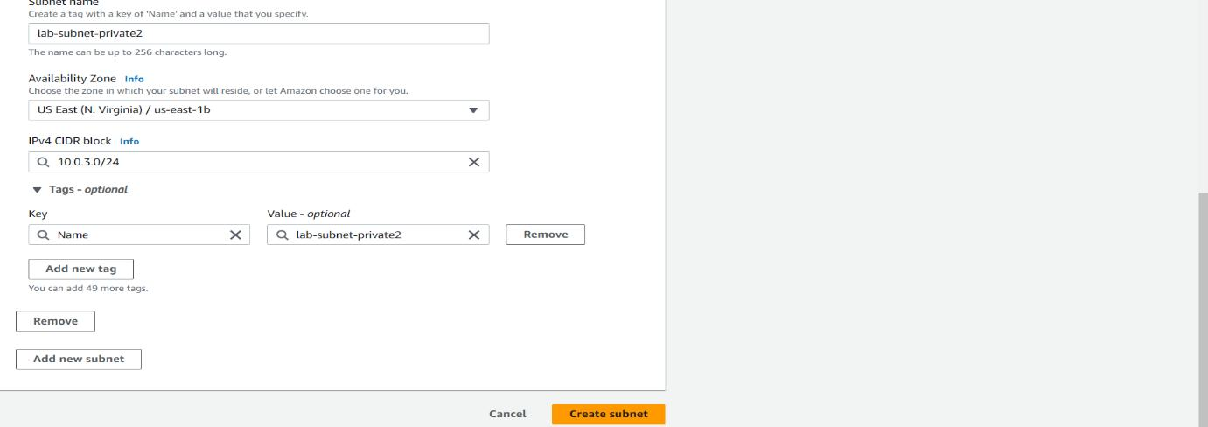
13.Again click on create subnet
VPC ID: lab-vpc
Subnet name: lab-subnet-private2
Availability Zone: Select the second Availability Zone
(for example, us-east-1b)
IPv4 CIDR block: 10.0.3.0/24
14. Choose create subnet

Slide 25
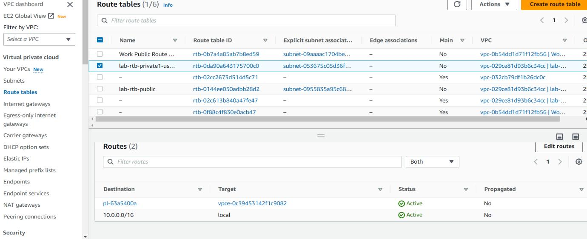
15. In the left navigation pane, choose Route tables.
16. Select the lab-rtb-private1-us-east-1a route table.
17.In the lower pane, choose the Routes tab.18. Choose the Subnet associations tab and choose Editsubnet associations
19. Leave lab-subnet-private1-us-east-1a selected, but also select lab-subnet-private2 and Save associations

Slide 26
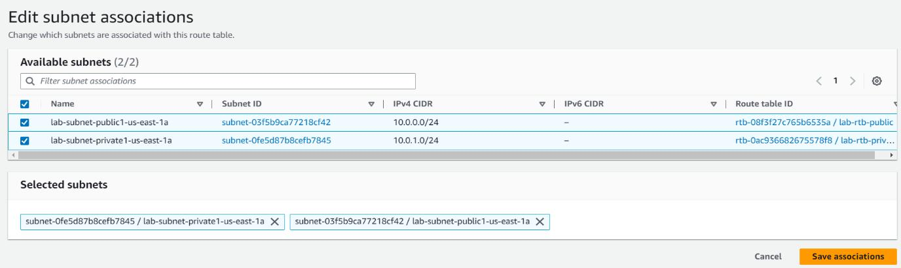
20. Select the lab-rtb-public route table
21. In the lower pane, choose the Routes tab.
22. Choose the Subnet associations tab and choose Edit subnet associations
23. Leave lab-subnet-public1-us-east-1a selected, but also select lab-subnet-public2 and Save association

Slide 27
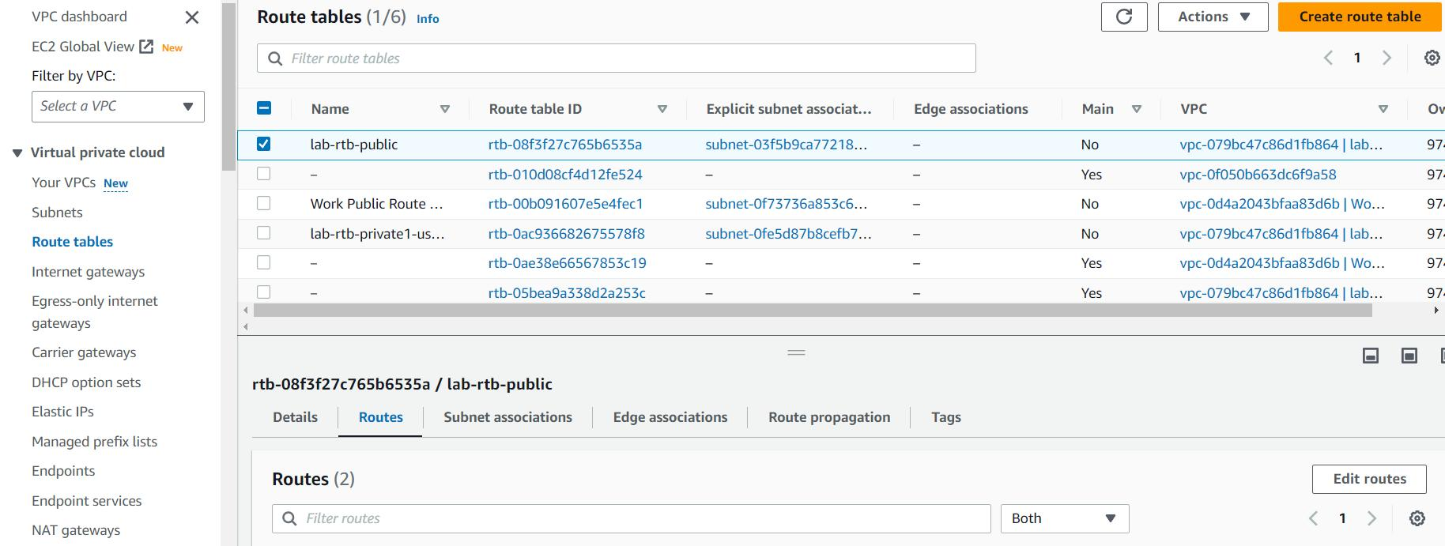
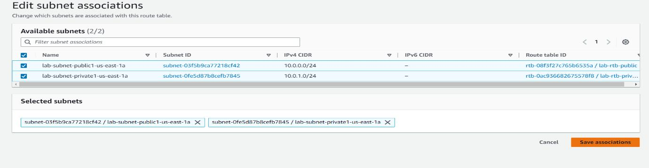

Slide 28
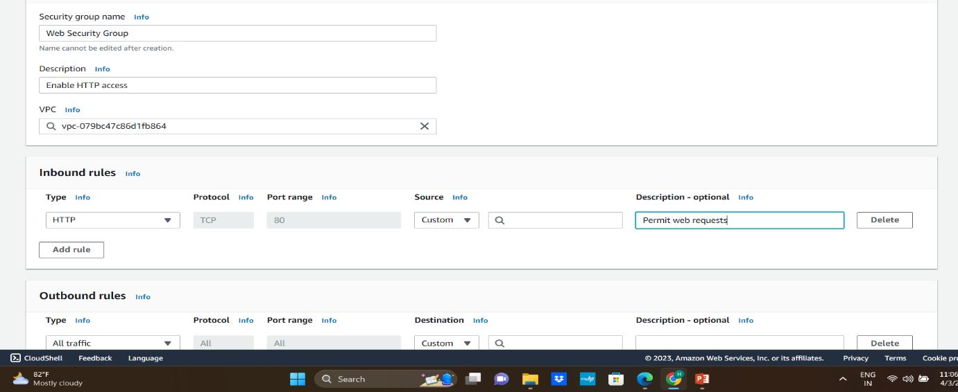
24In the left navigation pane, choose Security groups.
25.Choose Create security group and then configure
26. Security group name: Web Security Group
Description: Enable HTTP access
VPC: choose the X to remove the currently selected
VPC, then from the drop down list choose lab-vpc
24In the left navigation pane, choose Security groups.
25.Choose Create security group and then configure
26. Security group name: Web Security Group
Description: Enable HTTP access
VPC: choose the X to remove the currently selected
VPC, then from the drop down list choose lab-vpc

Slide 29
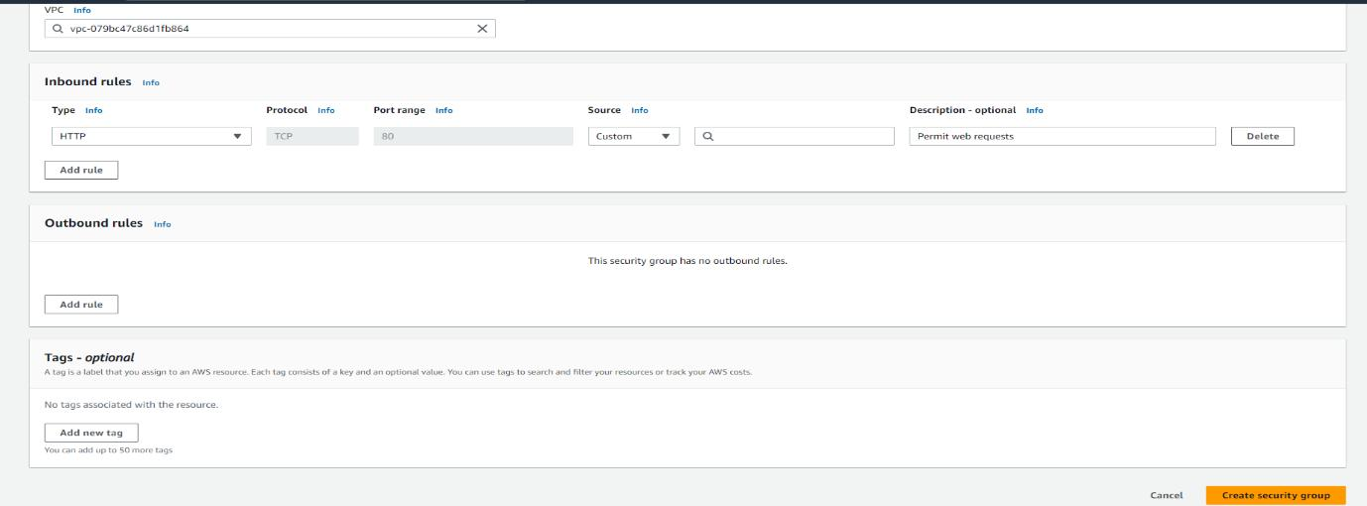
27. the Inbound rules pane, choose Add rules
28. Configure the following settings:
Type: HTTP
Source: Anywhere-IPv4
Description: Permit web requests
29. Scroll to the bottom of the page and choose Create security group

Slide 30
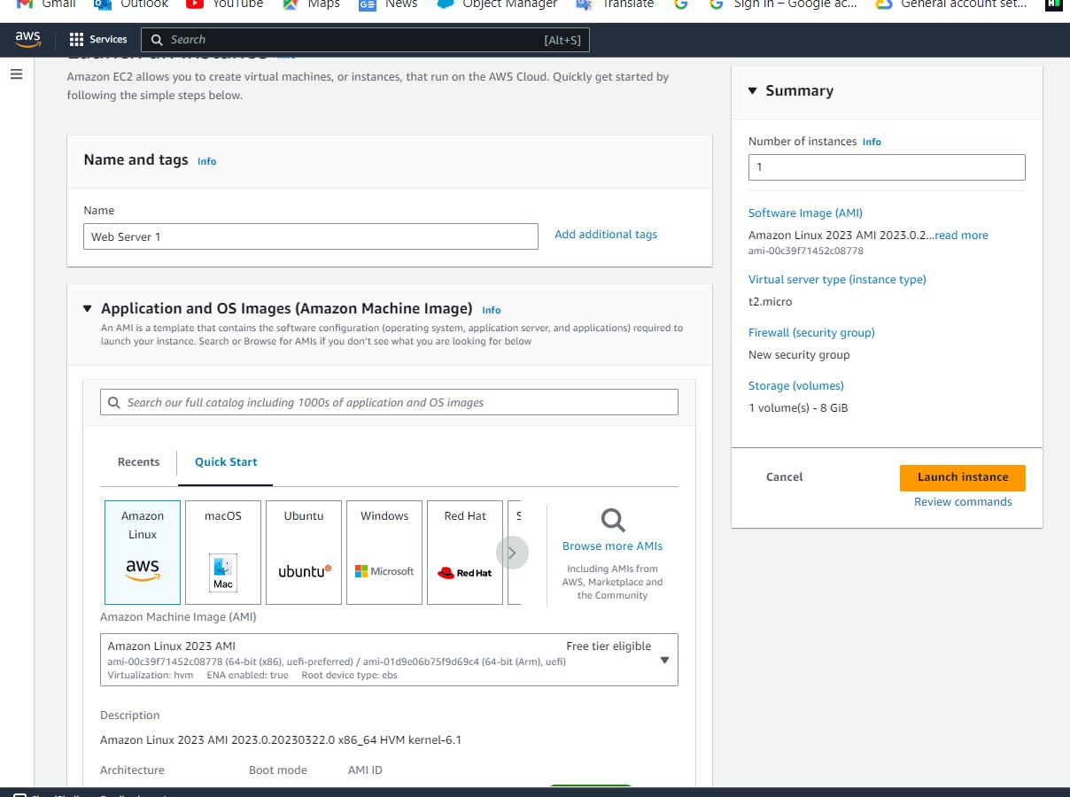
30. Services, search for and choose EC2 to open the EC2 console and choose Launch instance.
31. Name the instance:Web Server 1
32. Choose an AMI from which to create the instance and keep the default Amazon Linux selected.
33. Choose an Instance type:keep the default t2.microselected.
34. From the Key pair name menu, select vockey.
35. Configure the Network settings:choose Edit, then
configure:
Network: lab-vpc
Subnet: lab-subnet-public2 (not Private!)
Auto-assign public IP: Enable

Slide 31
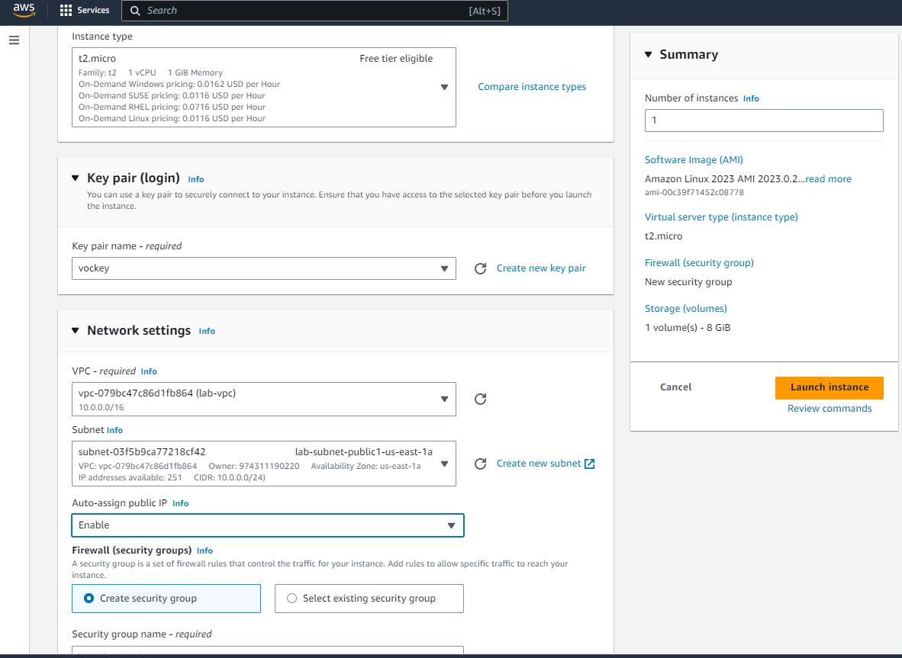
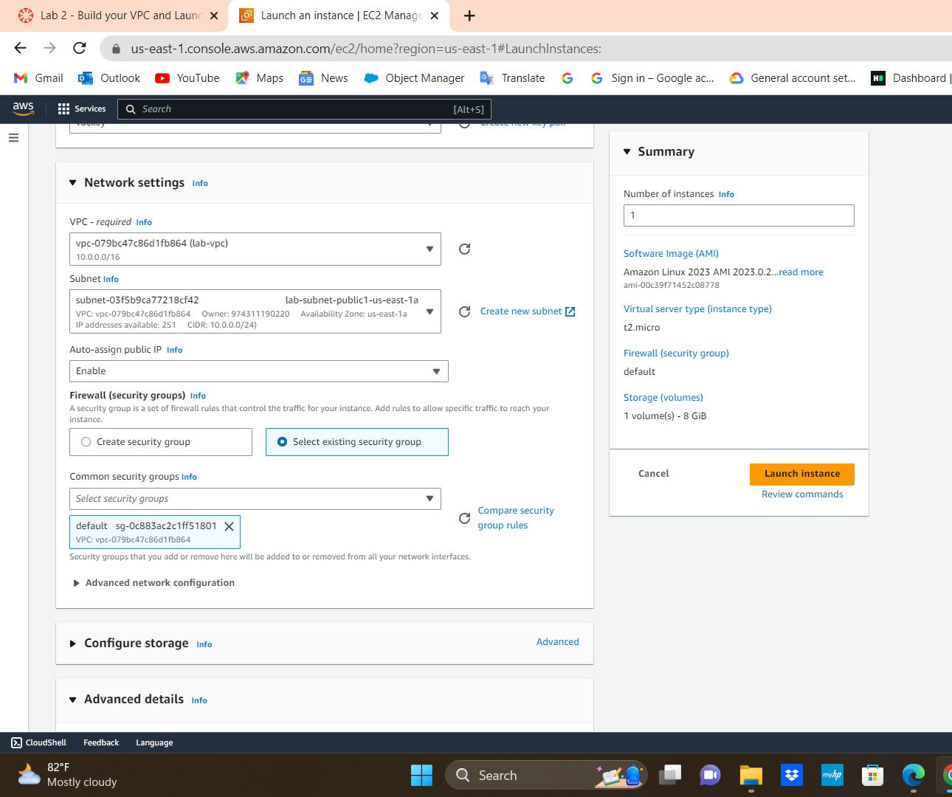
37. For Common security groups, select default
38. Expand the Advanced details panel.
39. Scroll to the bottom of the page enter the code in data
40. choose Launch instance and Choose View all instances

Slide 32
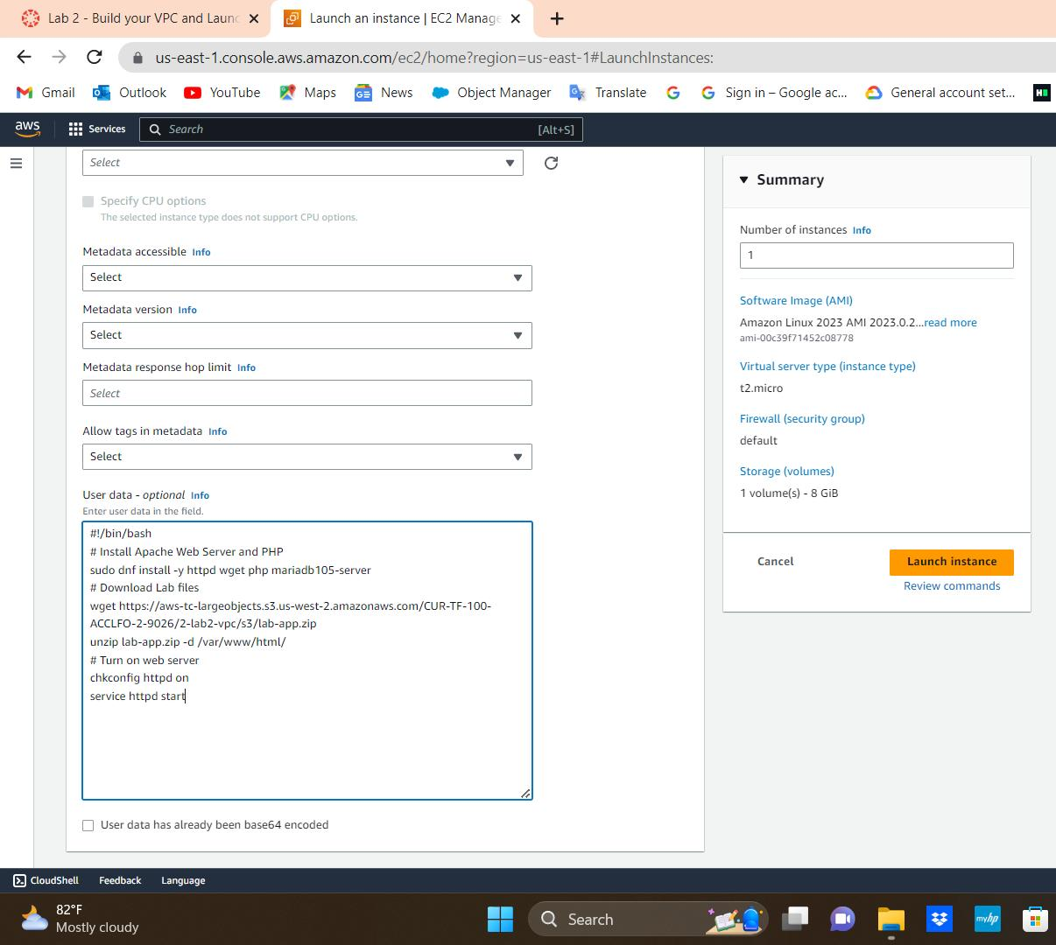
41. Wait until Web Server 1 shows 2/2 checks passed in the Status check column.
42. Select Web Server 1 and Copy the Public IPv4 DNS value shown in the Details tab at the bottom of the page.
43. Open a new web browser tab, paste the Public DNS value and press Enter and you should see a web page
displaying the AWS logo and instance meta-data values.

